Slide 1

SSWD – Project Presentation
Noman Sanaullah - 2893754, Gurcharn Singh Sikka - 2899330, Danish Ali - 2875170, Saujanya Bohara - 2892141

Slide 2
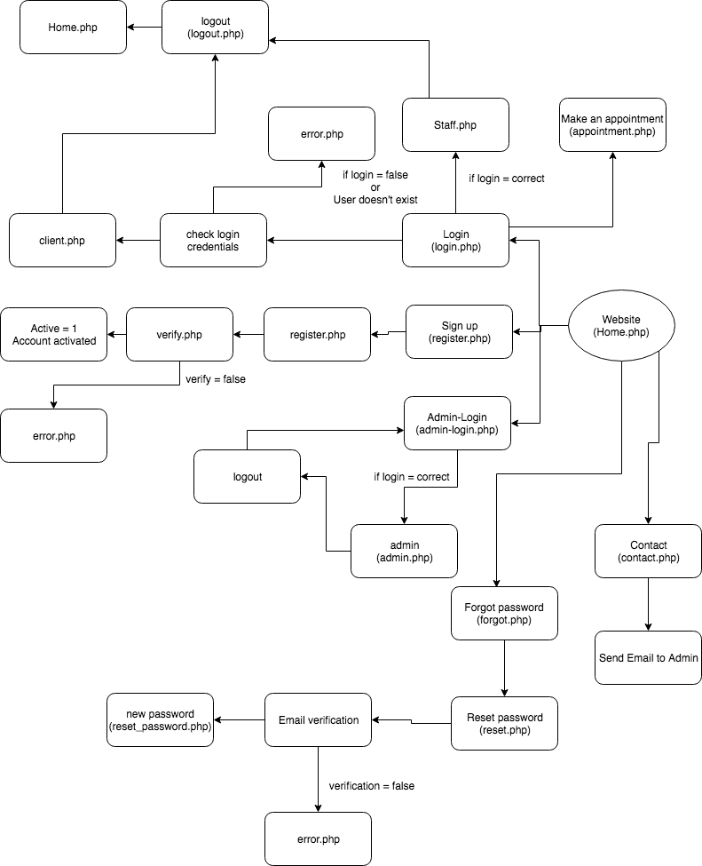
System Design

Slide 3
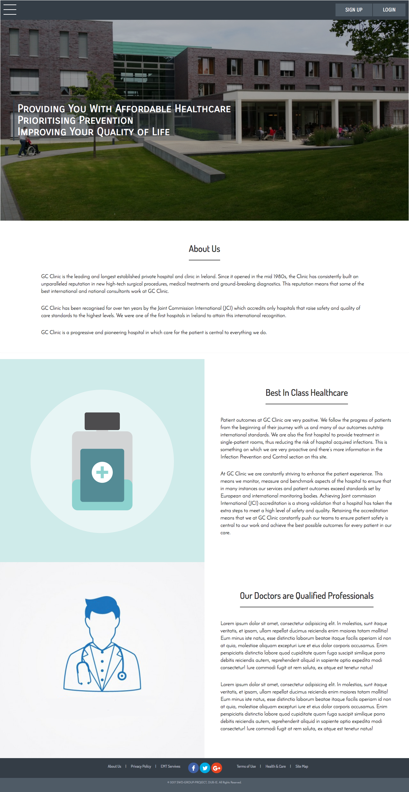
Visual Design

Slide 4
Visual Design

Slide 5
Visual Design

Slide 6
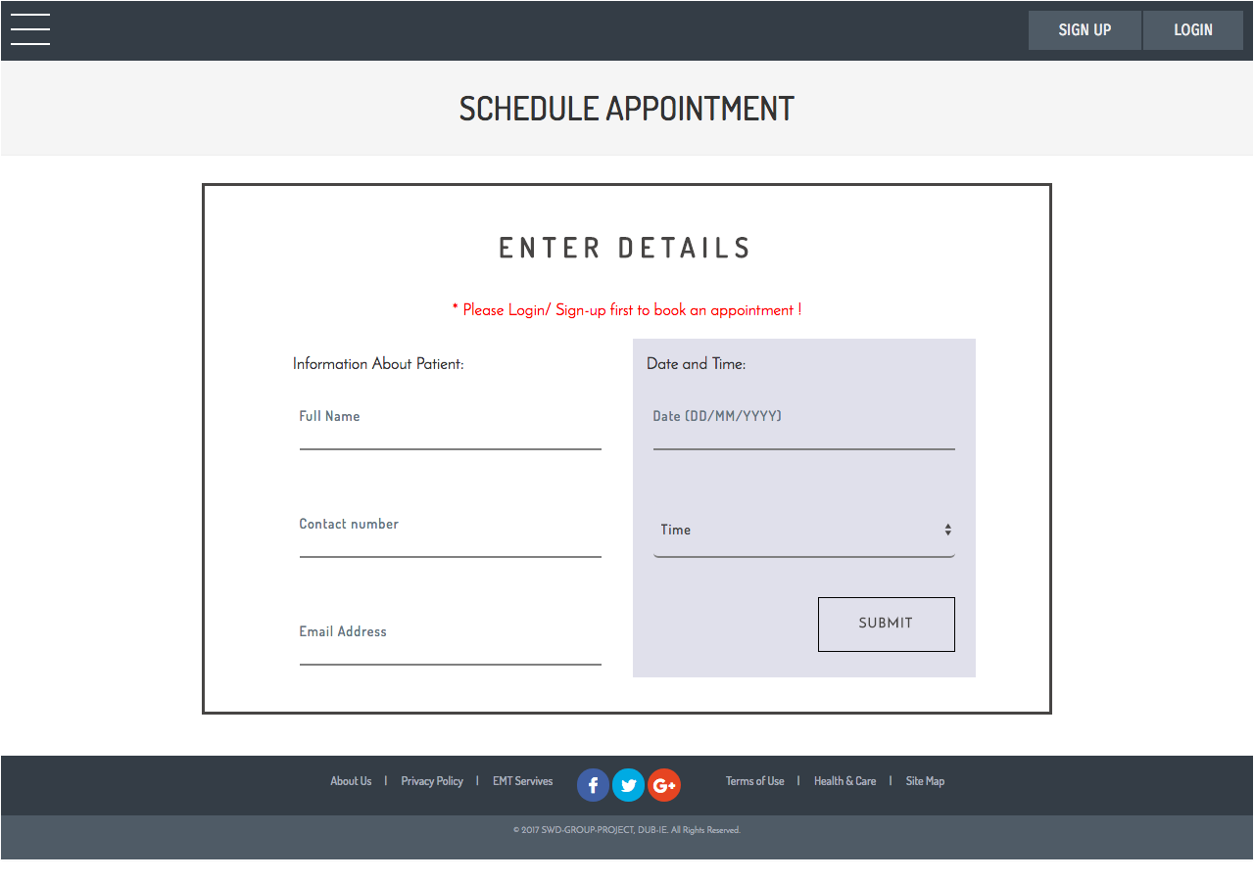
Visual Design

Slide 7
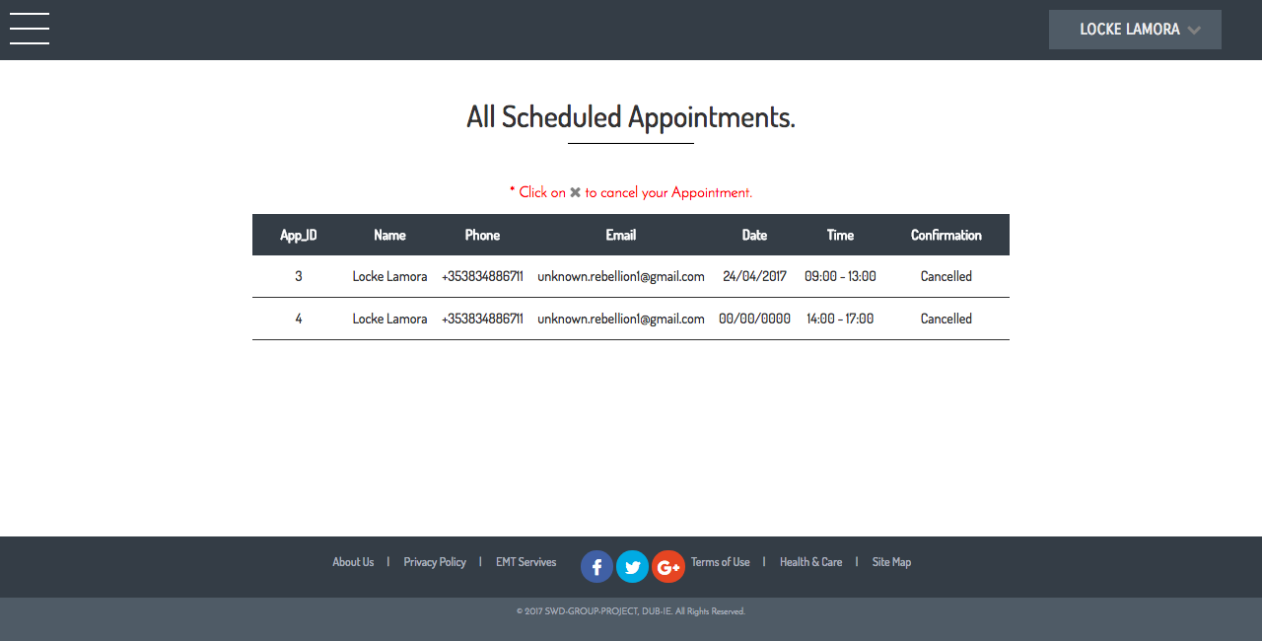
Visual Design

Slide 8
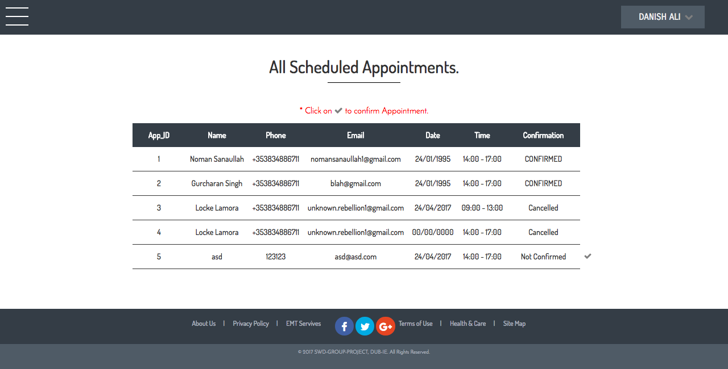
Visual Design

Slide 9
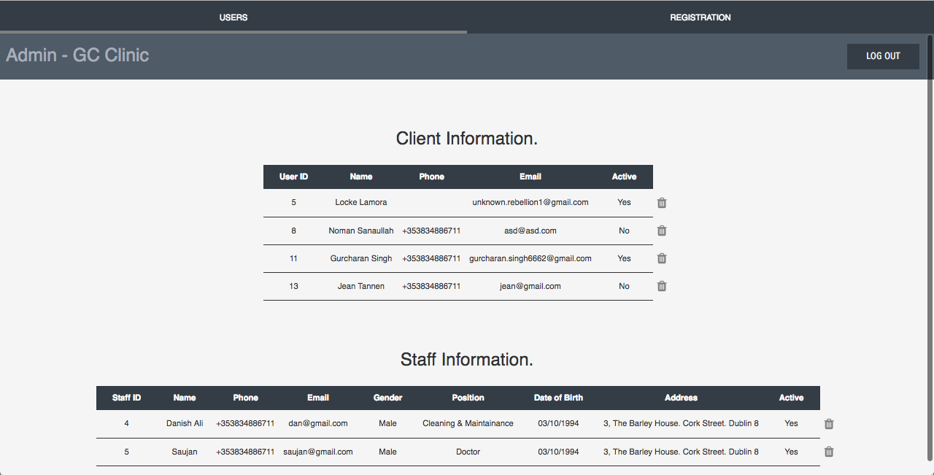
Visual Design

Slide 10
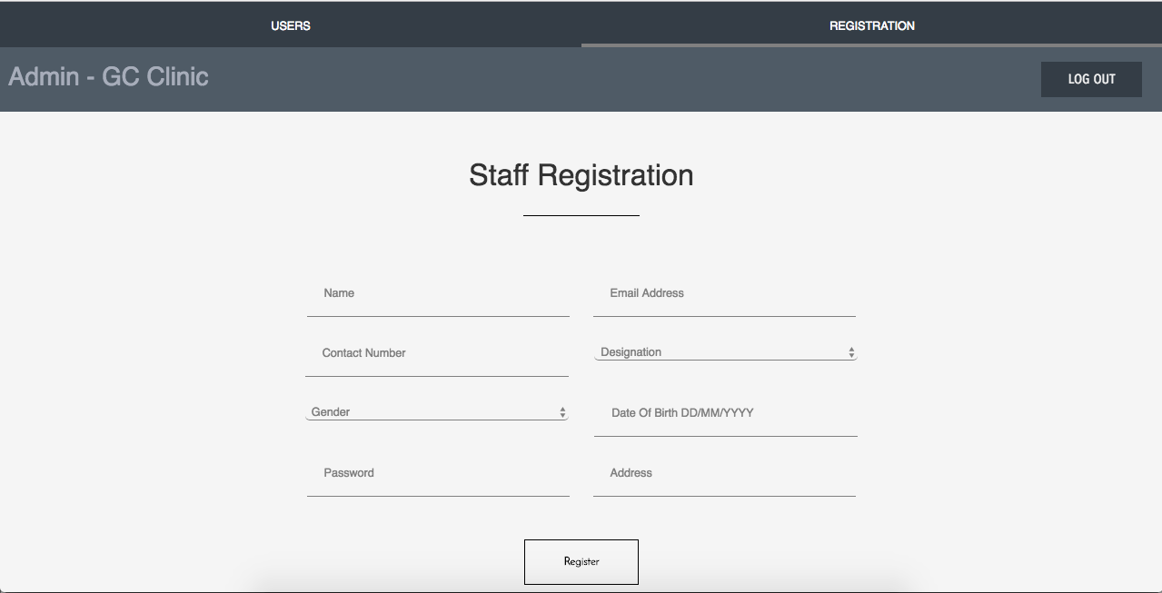
Visual Design

Slide 11
Extra Feature(s)
Password Reset Functionality:
Allows users to enter their email address
A verification link is sent, clicking on it opens a form
That form allows the users to change their password

Slide 12
What is missing?
Admin cannot dynamically add or change content of the page. We have only built the system as such that admin can only add or delete users.

